Slide 1

Optimizing Wastewater treatment
through Artificial Intelligence
Under the guidance of
Mrs.S.S.SARMILA M.C.A.,M.E.,
Assistant Professor
Presented by
Name: SOMU R
Roll No: 22BCA175

Slide 2

ALAGAPPA UNIVERSITY
State University | A++ Grade by NAAC(GCPA:3.59)in the 4th Cycle in dual mode | Category-I
University by MHRD-UGC
Karaikudi-630 003,Tamil Nadu, India
Next Gen IT Industry Trends AI and AGI
Optimizing Wastewater treatment through Artificial Intelligence
Department of Computer Applications
Co-ordinator: Dr.V. PALANISAMY, M.C.A., M.Tech., Ph.D. Senior Professor & Head

Slide 3
CONTENTS
ABSTRACT
EXSISTING SYSTEM
PROPOSED SYSTEM
SOFTWARE REQUIREMENTS
HARDWARE REQUIREMENTS
MODULES DESCRIPTION
DATA FLOW DIAGRAMS
UML DIAGRAMS
DATABASE DESIGN
USER INTERFACE DESIGN
CONCLUSION
FUTURE ENHANCEMENTS
BIBLIOGRAPHY

Slide 4
ABSTRACT
  Artificial intelligence (AI) is increasingly being applied to wastewater treatment to enhance efficiency, improve processes, and optimize resource utilization.
  This review focuses on objectives, advantages, outputs, and major findings of various AI models
  A critical aspect explored in this review is the cost-effectiveness of implementing AI systems in wastewater treatment.
  This project will deal with the aspects of water that must be considered in order to Optimize wastewater quality.
  Various machine learning techniques will be used to thoroughly suspect all the parameters.

Slide 5
EXISTING SYSTEM
  Various countries have been exploring the integration of AI in wastewater treatment to enhance efficiency, sustainability, and overall water management
  SENTRY, a US company, offers wastewater treatment systems with real-time water quality monitoring capabilities.
  DARROW researchers train AI models using data from a variety of sensors that monitor the water quality and wastewater treatment facility, which is located in the Netherlands.
  In order to estimate the quality of water of the Yamuna River in Delhi, India, the potential of four distinct neuro-fuzzy embedded metaheuristic algorithms was examined.

Slide 6
PROPOSED SYSTEM
  The environment, the economy, and human health can all be significantly harmed by low quality water.
  Water resources must be safeguarded and conserved for future generations, so it is crucial that individuals, governments, and companies take action.
  This can be accomplished through using natural resources responsibly, investing in water technology and infrastructure and raising public knowledge of water conservation and pollution prevention.
  The essential parameters must be identified, data must be gathered, pre-processed features must be extracted, models must be chosen and developed, models must be evaluated and finally the system must be deployed.
  The system can aid in the sustainable management of water resources by assisting in the identification of pollution sources, the detection of anomalies, and the prediction of future water quality levels.

Slide 7
HARDWARE REQUIREMENTS
  Processor : Intel(R) Core(TM) i3
  Ram : 4 GB
  Hard Disk Drive : 256 GB
  Microcontroller : ESP32 series, 32-bit dual-core MCU,
  Water Quality Sensors : PH ,Turbidity,Temperature probe
  Power supply : Voltage regulators
  Communication module : Thingspeak(Cloud)

Slide 8
SOFTWARE REQUIREMENTS
  Operating System : Windows 10/11
  Programming Environment : Arduino IDE,Google Colab
  Firmware Libraries : Sensor-specific libraries (e.g., for pH, turbidity)
  IoT Platform : Thingspeak IO(for visualizing sensor data)
  Cloud/Server Setup : ThingSpeak

Slide 9
MODULES
The Project contain the following modules:
Sensors (pH,Turbidity,TDS,Temperature probe)
ESP32 Wroom DA
Thinkspeak (Cloud)
Model Implementation Using ML
Condition Check for Potability of Water
Validation
Display Results on Web App

Slide 10
MODULE DESCRIPTION
  1.Sensors:
  - Sensors collect real-time data related to water quality parameters (e.g., pH, turbidity, temperature, etc.).
  2.ESP32:
  - The ESP32 microcontroller processes the sensor data and transmits it to the cloud for further analysis.
  3.Thinkspeak (Cloud):
  - ThingSpeak is an IoT analytics platform service that allows you to aggregate, visualize, and analyze live data streams in the cloud. You can send data to ThingSpeak from your devices, create instant visualization of live data, and send alerts.

Slide 11
MODULE DESCRIPTION
  4.Model Implementation Using ML:
  - Data from the cloud is processed using machine learning models to classify or predict water potability. Three ML algorithms are mentioned:
  Support Vector Machine (SVM): A supervised learning model used for classification tasks.
  Random Forest: An ensemble learning method that uses decision trees for improved accuracy.
  Extreme Gradient Boosting (XGBoost): A powerful gradient-boosted decision tree algorithm known for high performance.
  5.Condition Check for Potability of Water:
  - The output from the ML models is used to determine whether the water meets potability standards.

Slide 12
MODULE DESCRIPTION
  6.Validation:
  - The results are validated against predefined conditions or thresholds to ensure accuracy.
  7.Display Results on Web App:
  - The validated results are displayed on a web application for user access and monitoring.

Slide 13
DATA FLOW DIAGRAM
Sensors
Model implement using ML
ESP32
Support vector
Machine
Random Forest
Cloud
Extreme
(XG Boost)
Condition check for potability of water
Validation
Display Results on web app

Slide 14
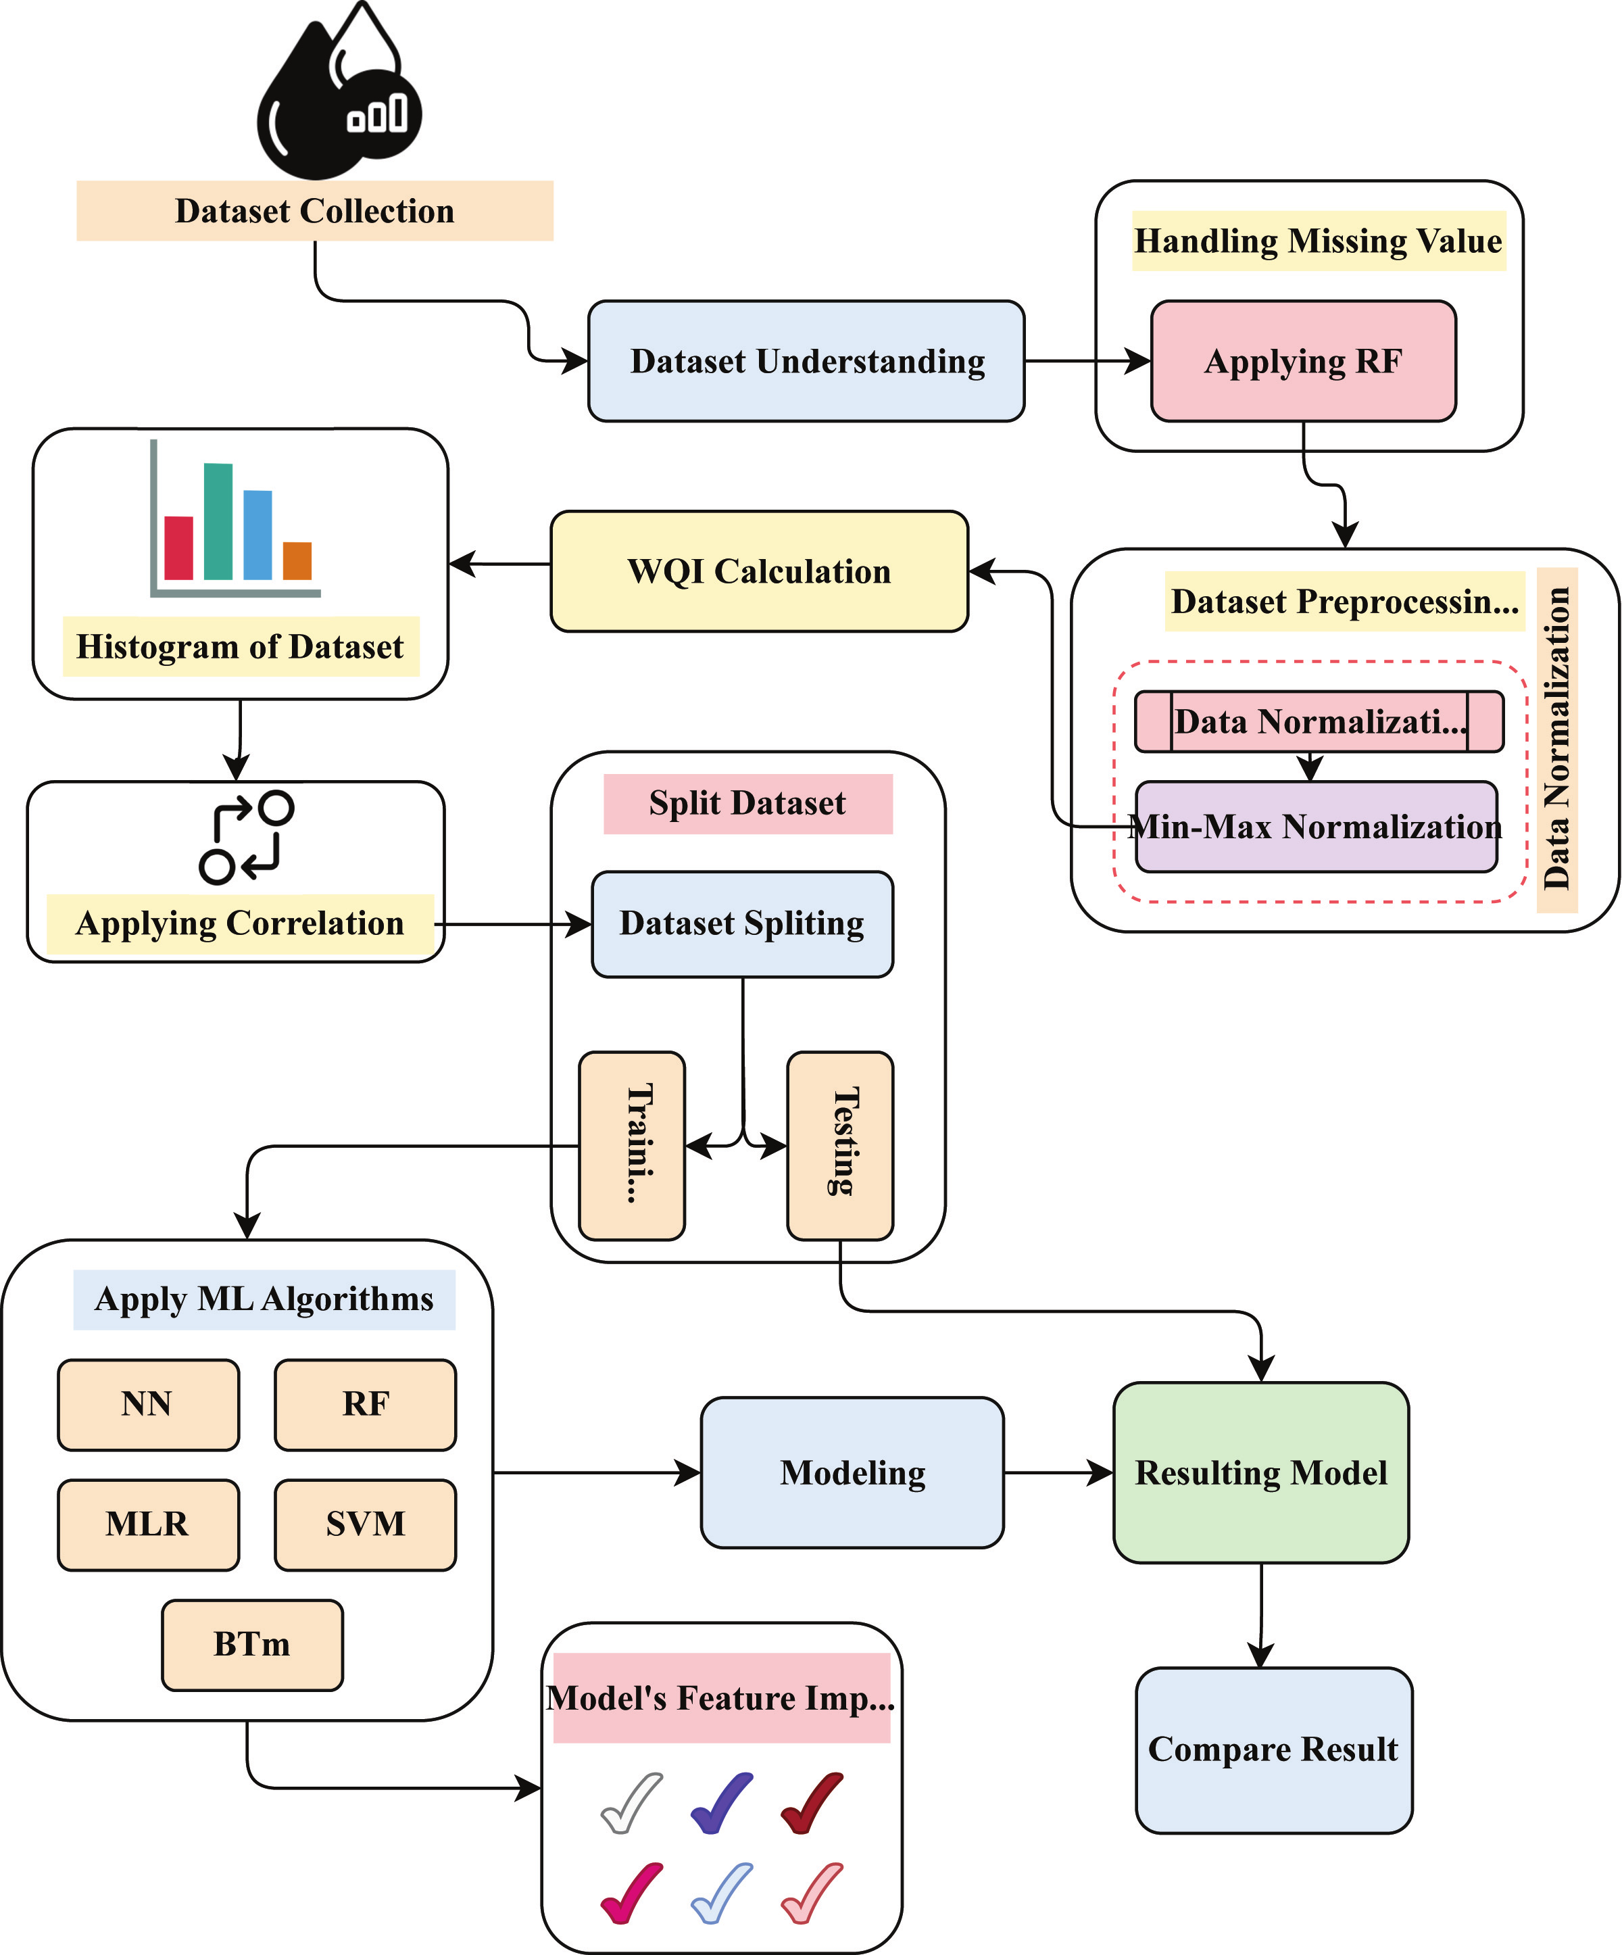
DATA FLOW DIAGRAM

Slide 15
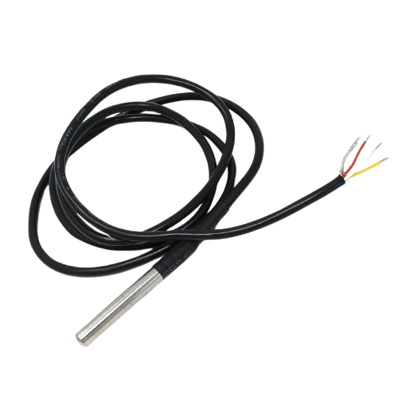
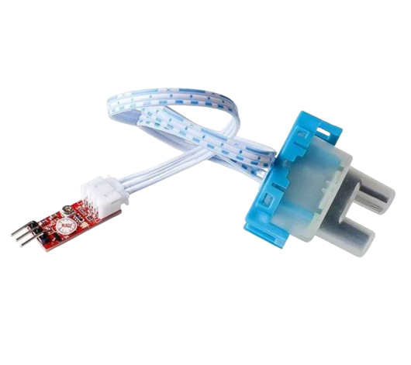
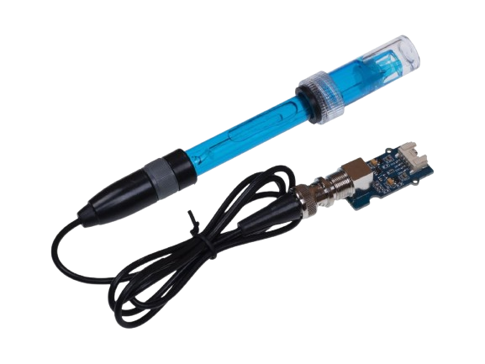
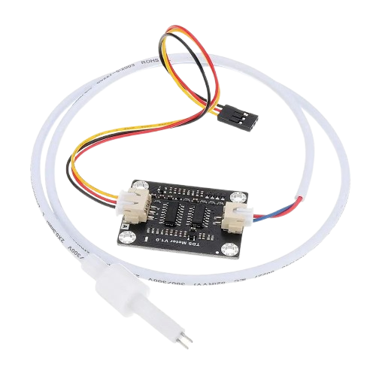
MODULE SCREENSHOT
Sensors
pH Sensor
Temperature probe
Turbitidy
Conductivity

Slide 16
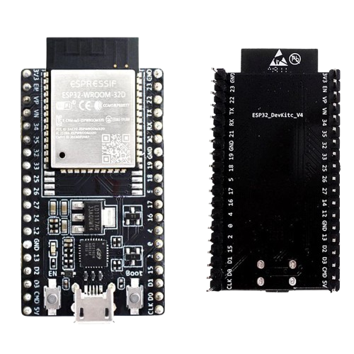
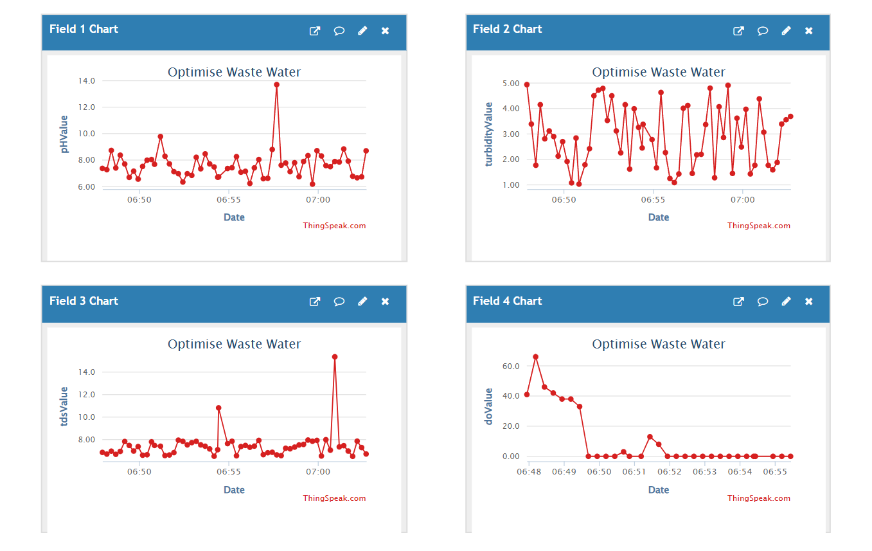
MODULE SCREENSHOT
ESP32 WROOM
Display Result on Web App

Slide 17
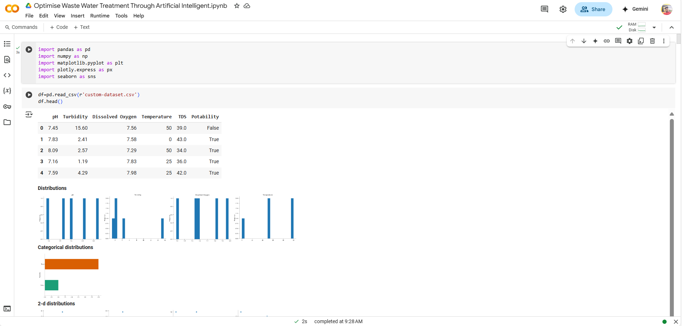
MODULE SCREENSHOT

Slide 18
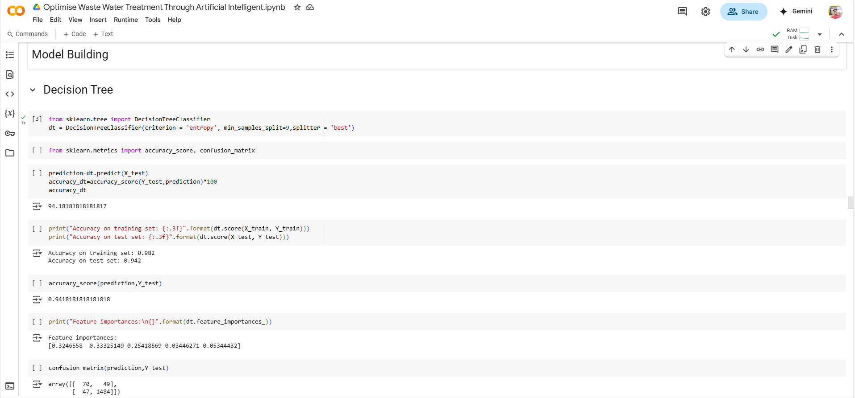
MODULE SCREENSHOT
Model Implementation Using ML

Slide 19
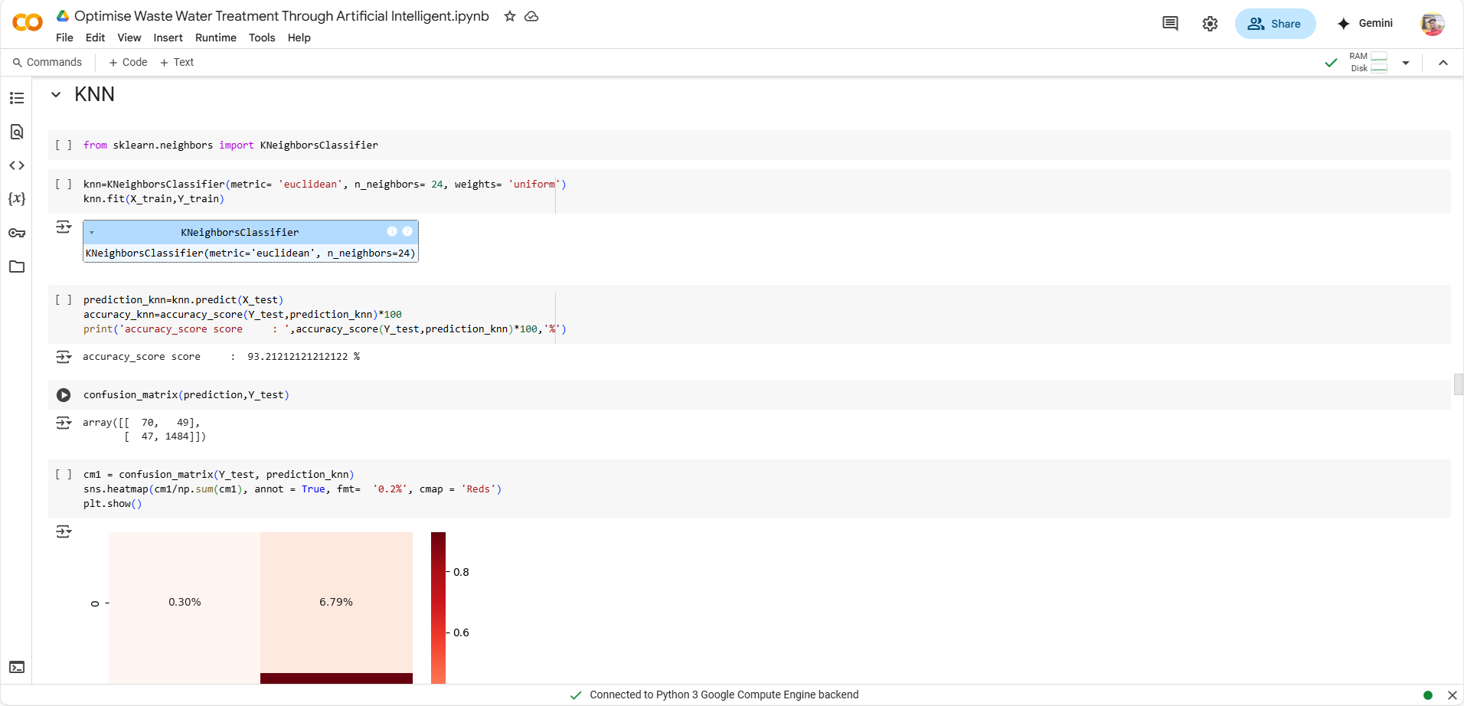
MODULE SCREENSHOT

Slide 20
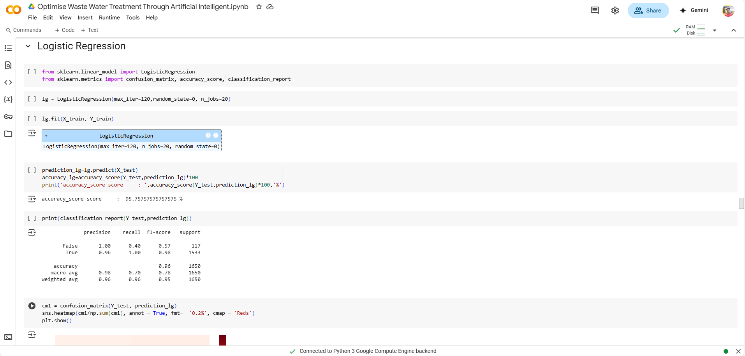
MODULE SCREENSHOT

Slide 21
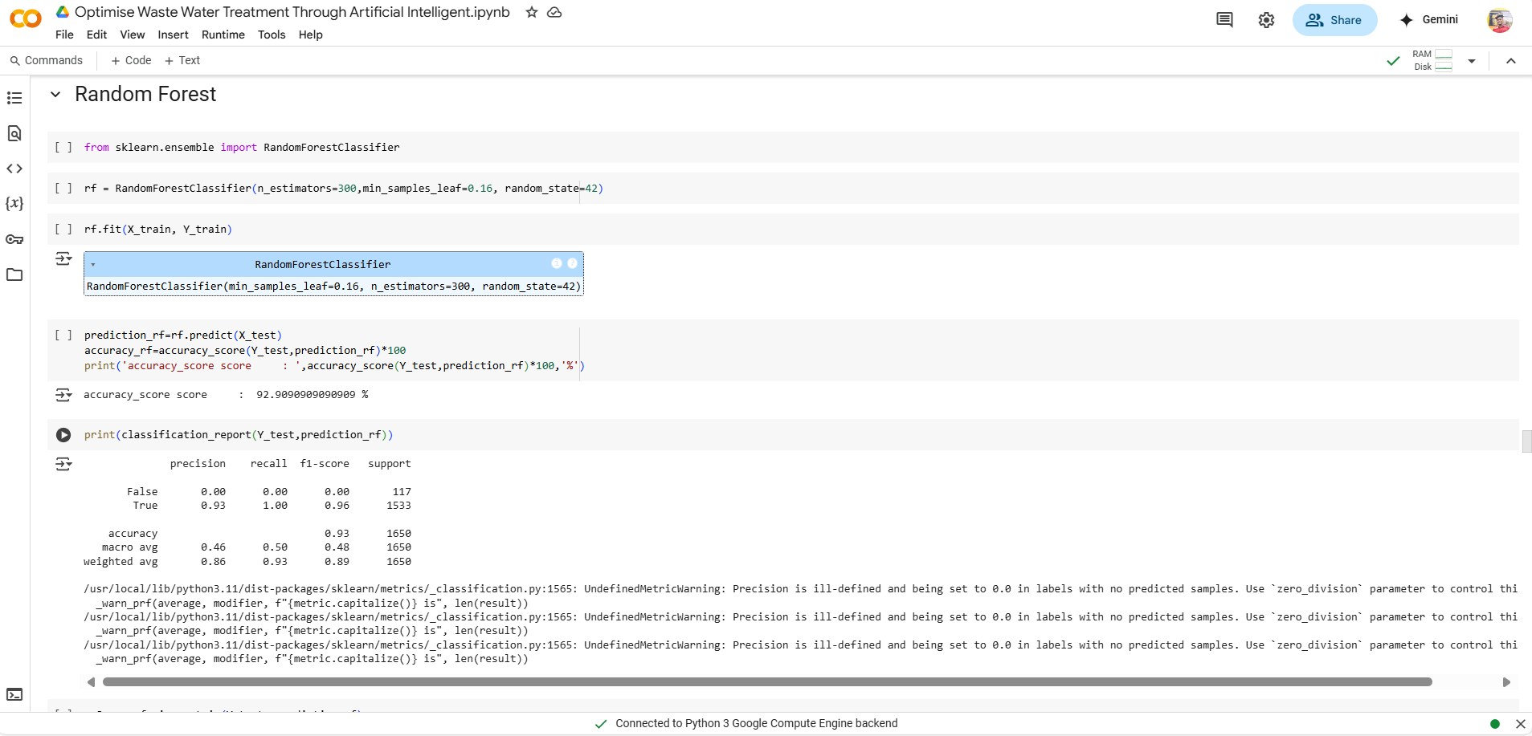
MODULE SCREENSHOT

Slide 22
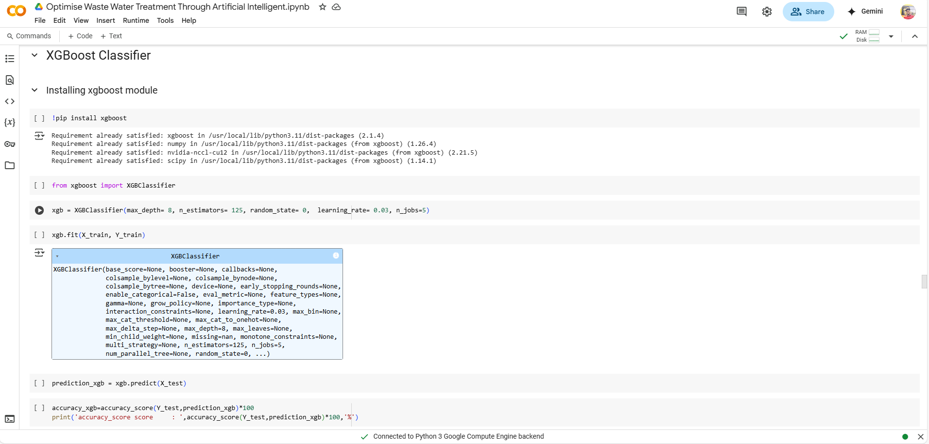
MODULE SCREENSHOT

Slide 23
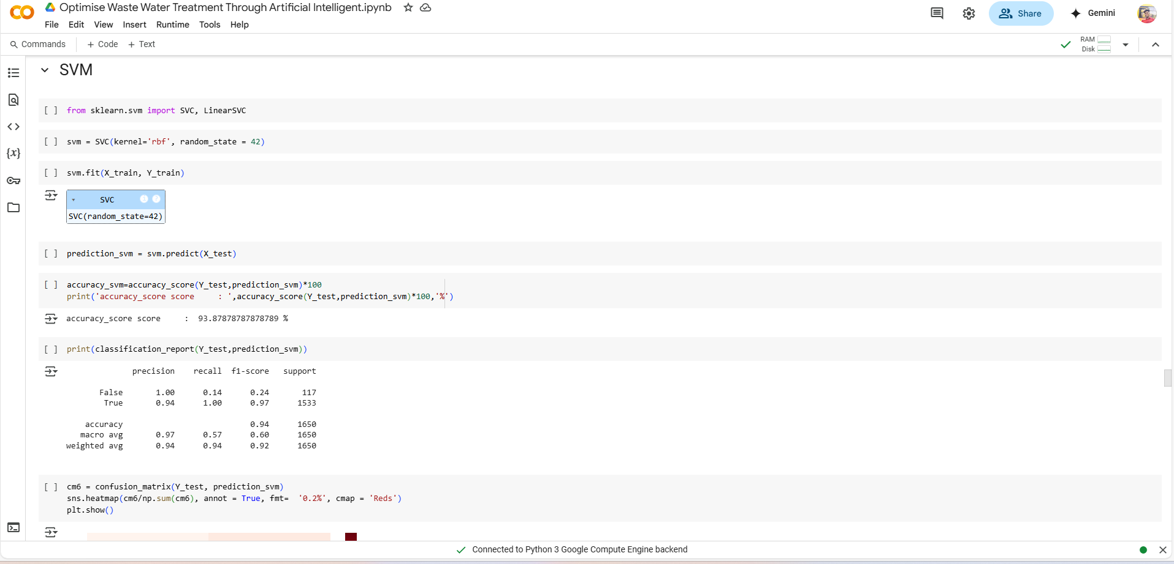
MODULE SCREENSHOT

Slide 24
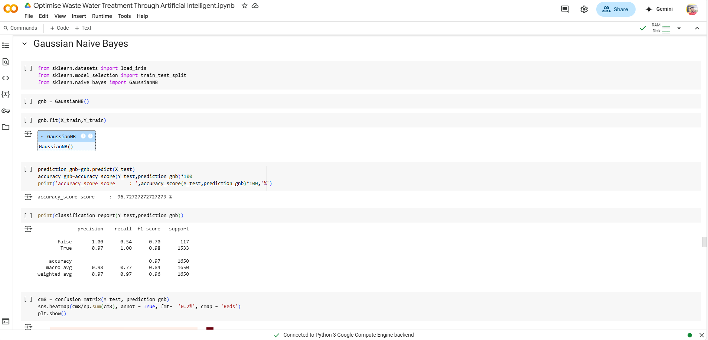
MODULE SCREENSHOT

Slide 25
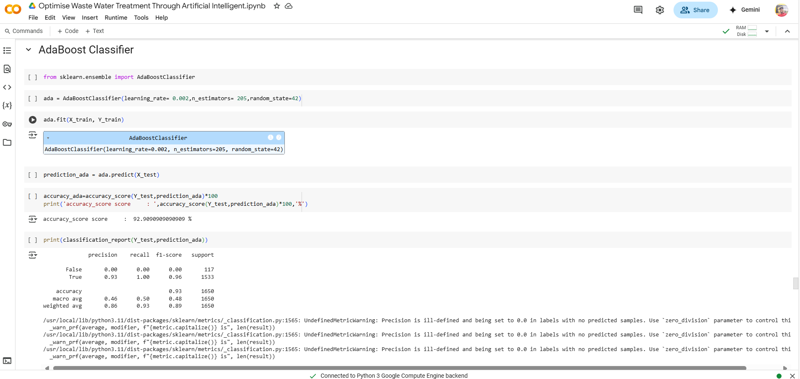
MODULE SCREENSHOT

Slide 26
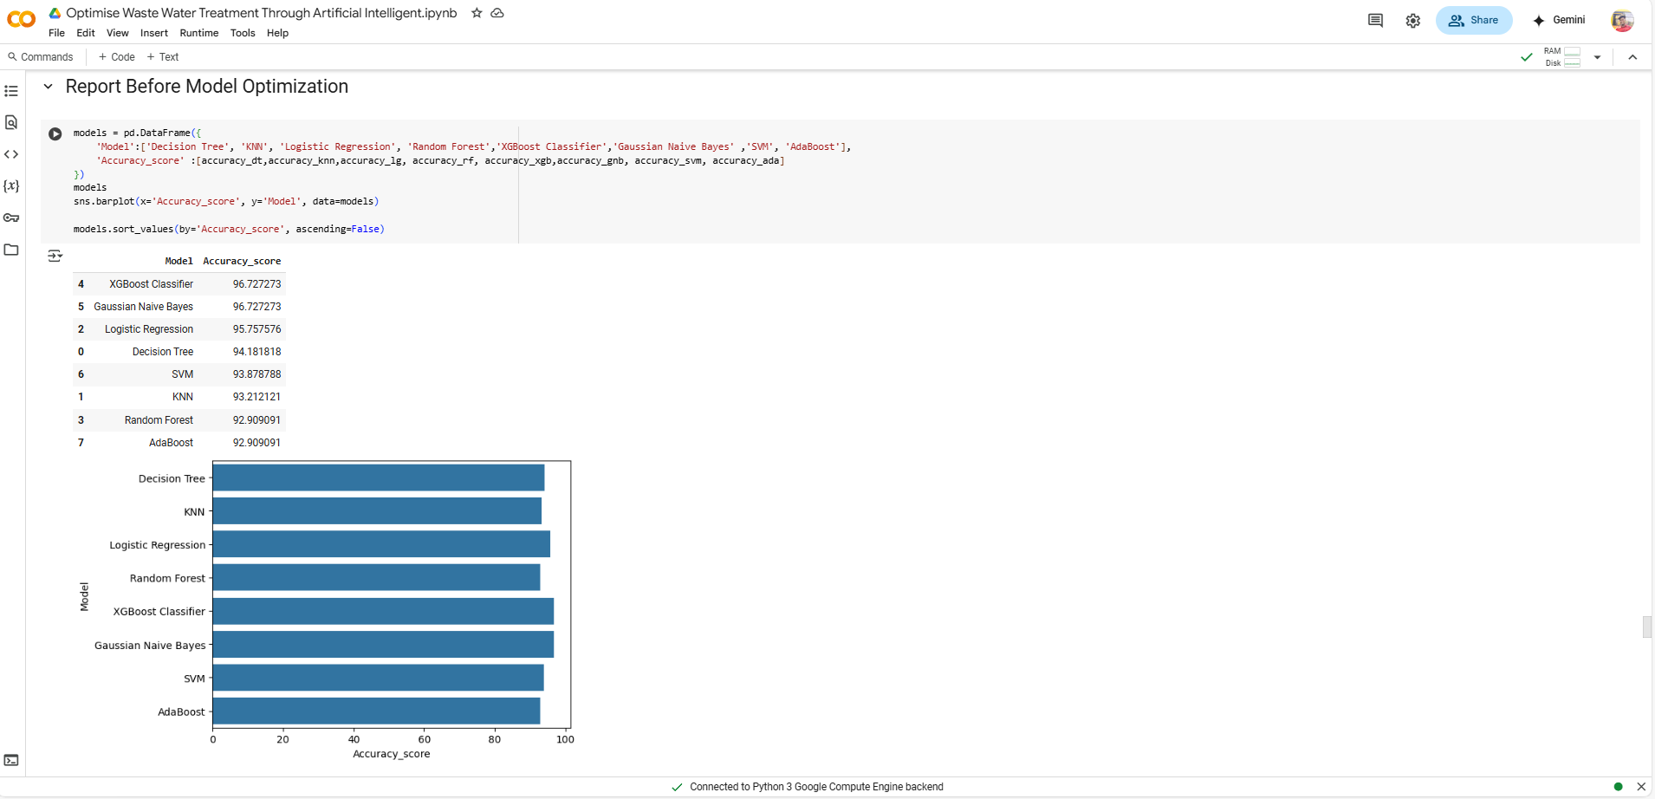
MODULE SCREENSHOT

Slide 27

MODULE SCREENSHOT

Slide 28
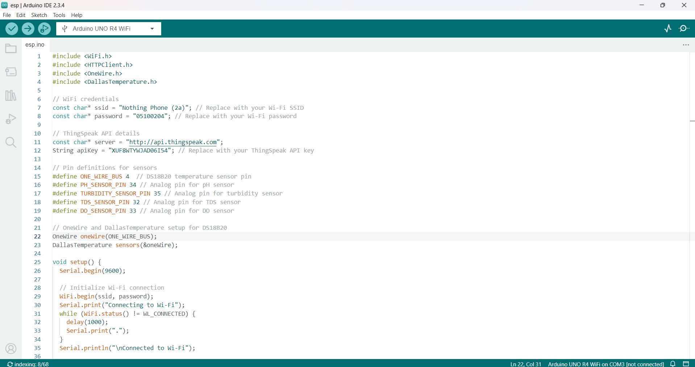
SAMPLE SOURCE CODE

Slide 29
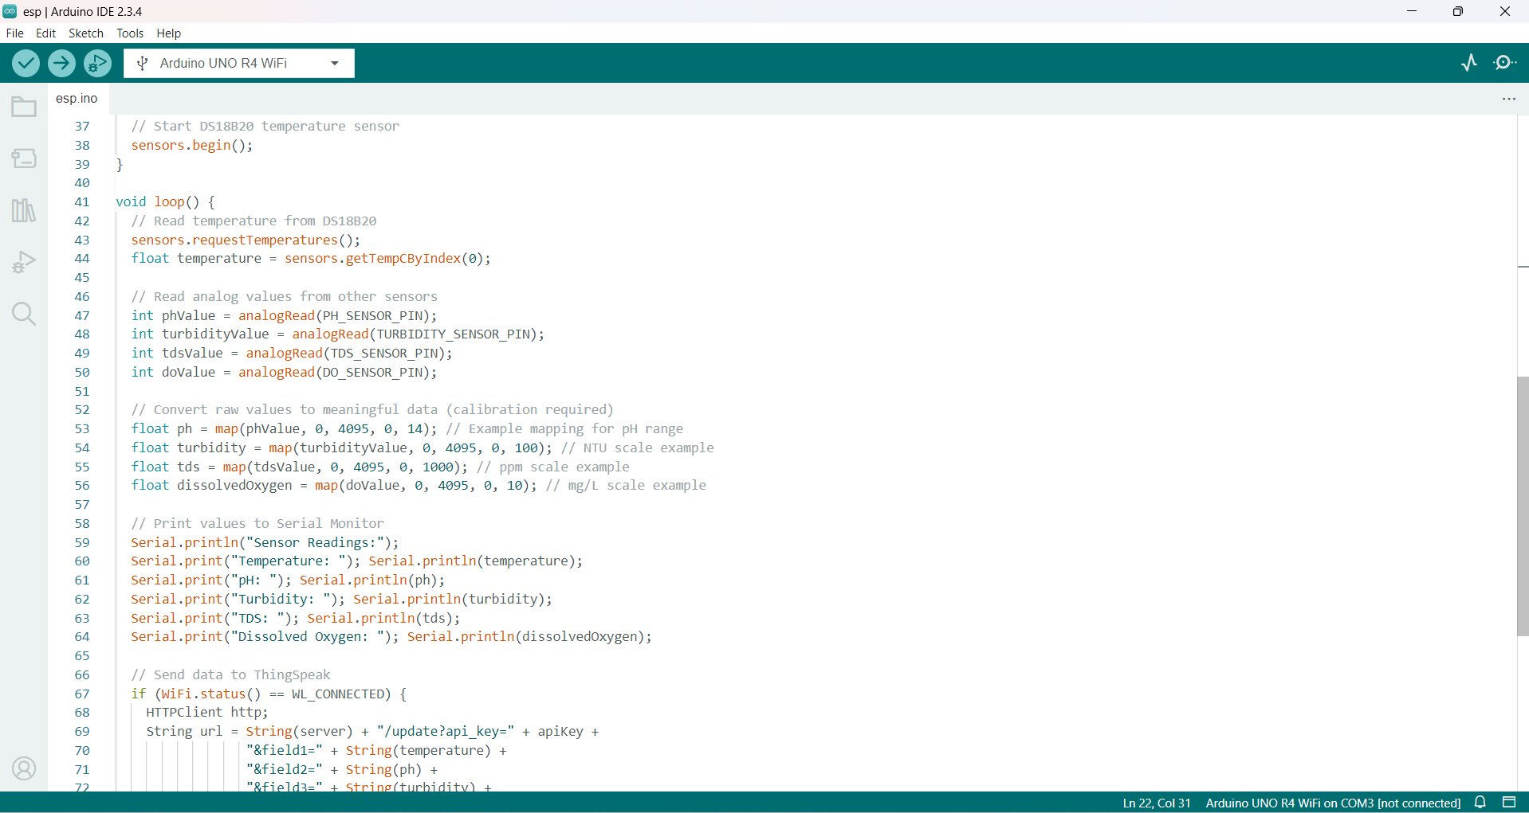
SAMPLE SOURCE CODE

Slide 30
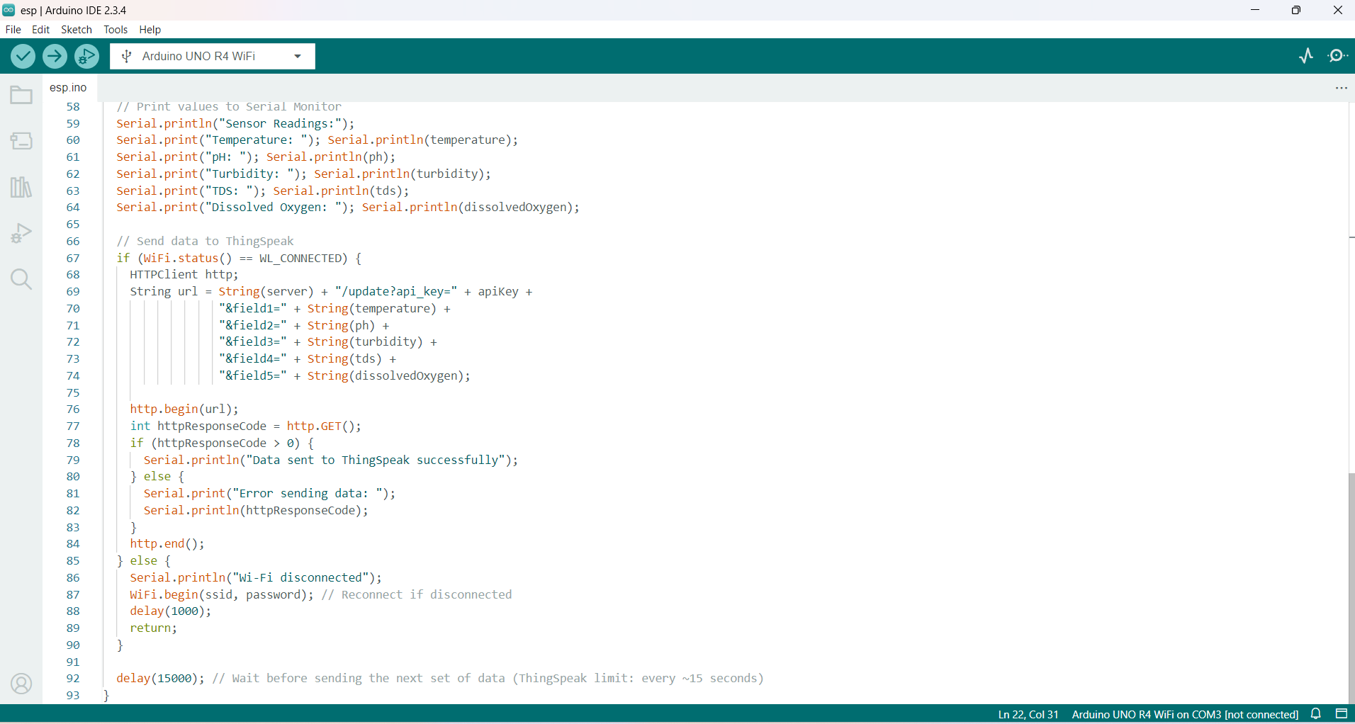
SAMPLE SOURCE CODE

Slide 31
CONCLUSION
  The potability of the water, which is determined by factors like turbidity, pH, and TDS, will be properly predicted by our suggested method, indicating whether the water is suitable for human consumption or not.
  In this project, we offer a model that fuses artificial intelligence with the internet of things.
  Multiple sensors and microcontrollers are utilised to assess the TDS, pH, and turbidity data that were validated since the model used machine learning techniques.
  More sensors can be added in the future to expand the range of properties (such temperature, pH, and dissolved oxygen) that our model can examine

Slide 32
FUTURE ENHANCEMENT
  Artificial intelligence (AI) is increasingly being applied to wastewater treatment to enhance efficiency, improve processes, and optimize resource utilization.
  This review focuses on objectives, advantages, outputs, and major findings of various AI models
  A critical aspect explored in this review is the cost-effectiveness of implementing AI systems in wastewater treatment.
  This project will deal with the aspects of water that must be considered in order to Optimize wastewater quality.
  Various machine learning techniques will be used to thoroughly suspect all the parameters.

Slide 33
BIBILOGRAPHY
  Artificial intelligence (AI) is increasingly being applied to wastewater treatment to enhance efficiency, improve processes, and optimize resource utilization.
  This review focuses on objectives, advantages, outputs, and major findings of various AI models
  A critical aspect explored in this review is the cost-effectiveness of implementing AI systems in wastewater treatment.
  This project will deal with the aspects of water that must be considered in order to Optimize wastewater quality.
  Various machine learning techniques will be used to thoroughly suspect all the parameters.

Slide 34


